Slide 1
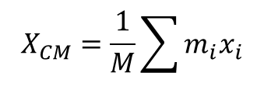
Lecture-8
Center of Mass (1D)
The center of mass is the point in a body or system of bodies at which the whole mass may be considered as concentrated.
M = m₁ + m₂
m₁
M
m₂
0
x₁
x₂
x_{cm}
M x_{cm} = m₁ x₁ + m₂ x₂
moment of M = moment of individual masses
$$X_{CM}=\frac{1}{M}\sum{m_{i}x_{i}}$$
In general

Slide 2
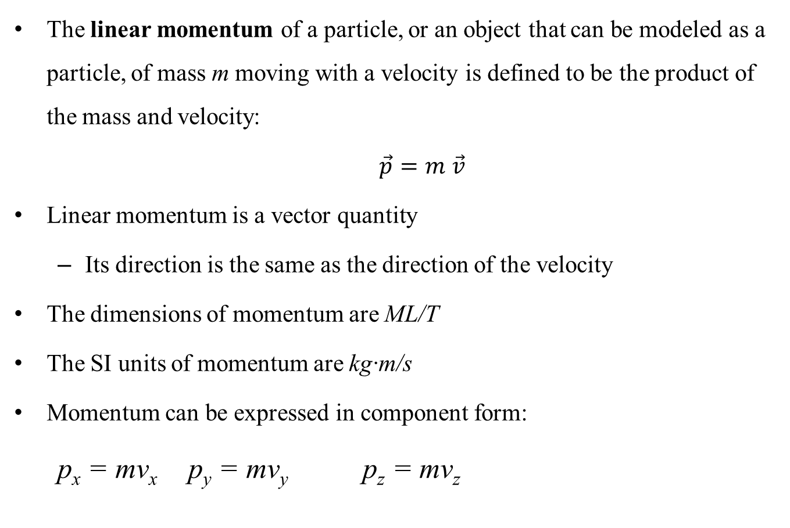
Linear Momentum
The linear momentum of a particle, or an object that can be modeled as a particle, of mass m moving with a velocity is defined to be the product of the mass and velocity:
$\vec{p}=m$ $\vec{v}$
Linear momentum is a vector quantity
Its direction is the same as the direction of the velocity
The dimensions of momentum are ML/T
The SI units of momentum are kg·m/s
Momentum can be expressed in component form:
p_{x} = mv_{x} p_{y} = mv_{y} p_{z} = mv_{z}

Slide 3
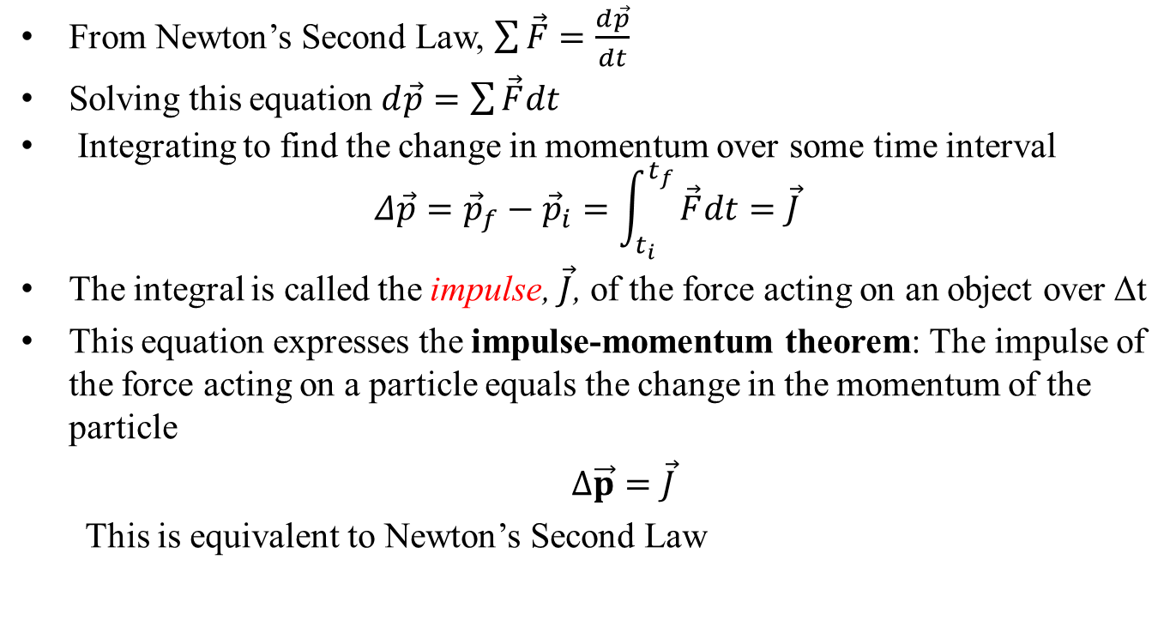
Impulse
From Newton’s Second Law, $\sum{\vec{F}}=\frac{d\vec{p}}{dt}$
Solving this equation $d\vec{p}=\sum{\vec{F}dt}$
Integrating to find the change in momentum over some time interval
$$Δ\vec{p}={\vec{p}}_{f}−{\vec{p}}_{i}=\int_{t_{i}}^{t_{f}}{\vec{F}dt}=\vec{J}$$
The integral is called the impulse, $\vec{J}$, of the force acting on an object over Δt
This equation expresses the impulse-momentum theorem: The impulse of the force acting on a particle equals the change in the momentum of the particle
$Δ\vec{p}=\vec{J}$
This is equivalent to Newton’s Second Law

Slide 4
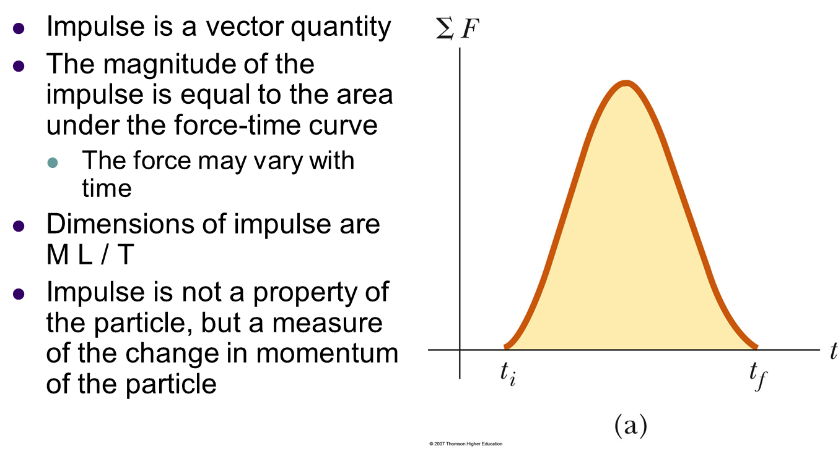
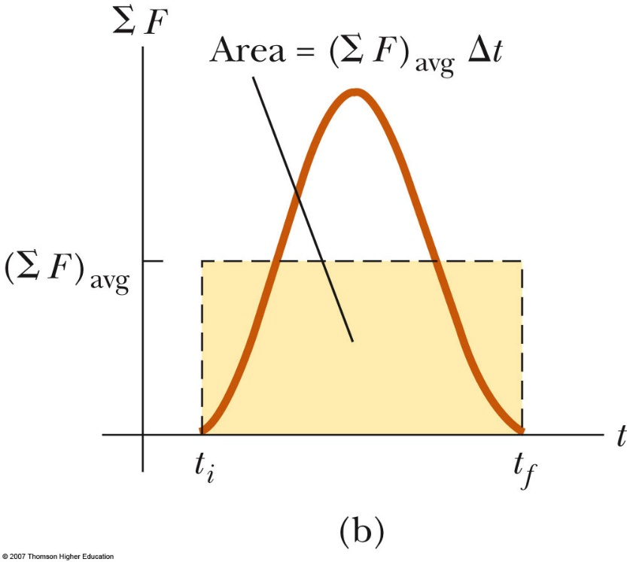
More about Impulse
Impulse is a vector quantity
The magnitude of the impulse is equal to the area under the force-time curve
The force may vary with time
Dimensions of impulse are ML/T
Impulse is not a property of the particle but a measure of the change in momentum of the particle
The impulse can also be found by using the time averaged force
This would give the same impulse as the time-varying force does

Slide 5
Conservation of Linear Momentum
Whenever two or more particles in an isolated system interact, the total momentum of the system remains constant
The momentum of the system is conserved, not necessarily the momentum of an individual particle
This also tells us that the total momentum of an isolated system equals its initial momentum
Conservation of momentum can be expressed mathematically in various ways
In component form, the total momenta in each direction are independently conserved
p_{ix} = p_{fx} p_{iy} = p_{fy} p_{iz} = p_{fz}
Conservation of momentum can be applied to systems with any number of particles
This law is the mathematical representation of the momentum version of the isolated system model

Slide 6
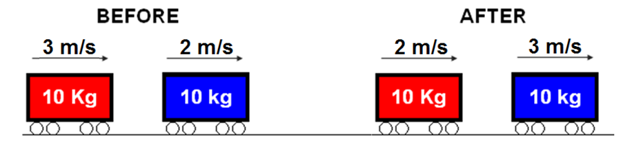
Conservation of Linear Momentum
Principle that states that the total momentum of an isolated system stays constant.
Total momentum before a collision equals total momentum after a collision
p = 30 kg·m/s
p = 20 kg·m/s
p = 20 kg·m/s
p = 30 kg·m/s
Total = 50 kg·m/s
Total = 50 kg·m/s

Slide 7
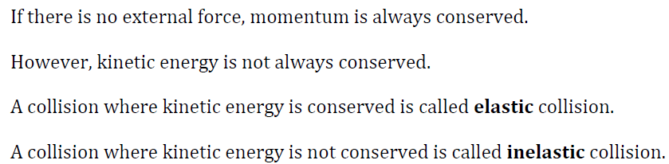
Elastic Collision: When kinetic energy before collision is equal to kinetic energy after the collision that means kinetic energy is conserved. This types of collision is called elastic collision.
Elastic & Inelastic collision
Inelastic Collision: When kinetic energy before collision is not equal to kinetic energy after the collision that means kinetic energy is not conserved. This types of collision is called inelastic collision.
Important Notes:

Slide 8
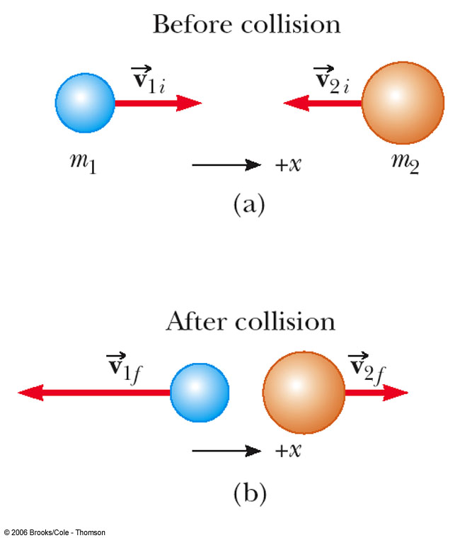
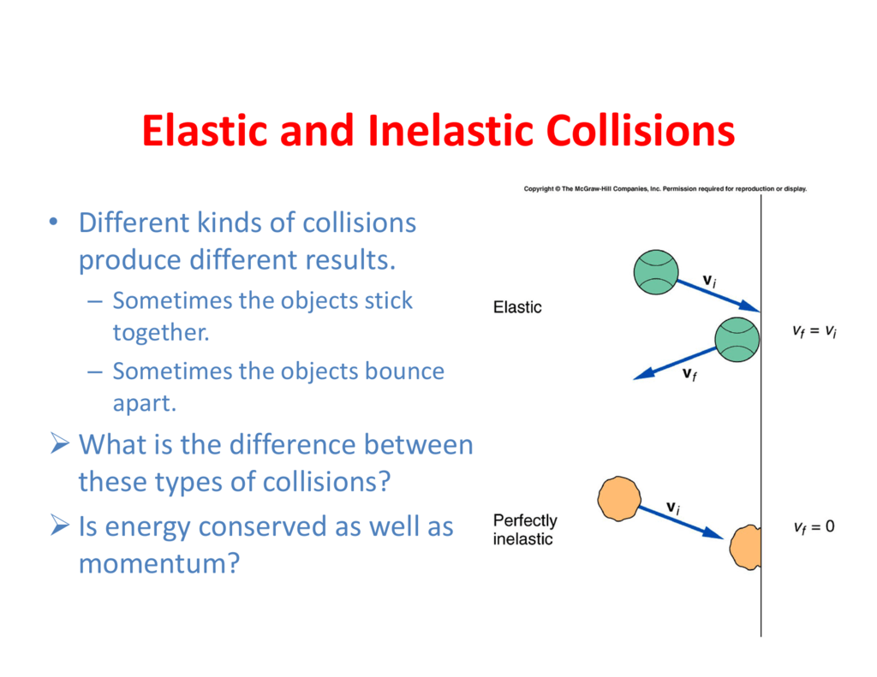
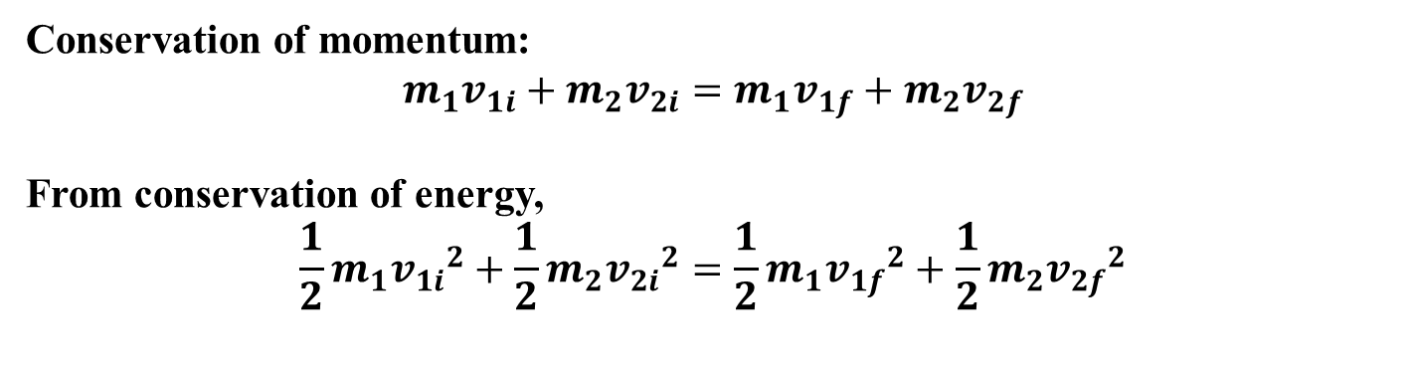
More About Elastic Collisions
Conservation of momentum:
$$m_{1}v_{1i}+{m_{2}v}_{2i}=m_{1}v_{1f}+{m_{2}v}_{2f}$$
From conservation of energy,
$${\frac{1}{2}m}_{1}{v_{1i}}^{2}+{\frac{1}{2}m}_{2}{v_{2i}}^{2}={\frac{1}{2}m}_{1}{v_{1f}}^{2}+{\frac{1}{2}m}_{2}{v_{2f}}^{2}$$

Slide 9
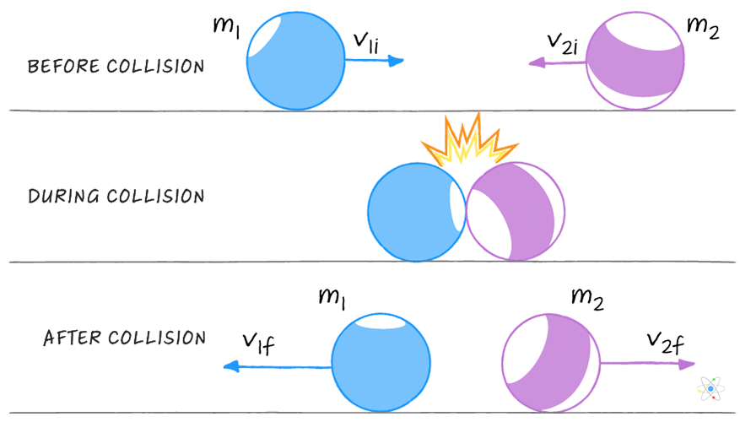

More About Inelastic Collisions
Only momentum will conserve:
$$m_{1}v_{1i}+{m_{2}v}_{2i}=m_{1}v_{1f}+{m_{2}v}_{2f}$$

Slide 10
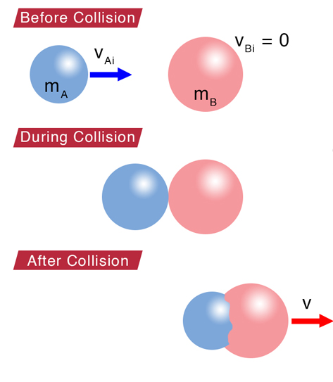

Completely (Perfectly) inelastic collision: The inelastic collision of two bodies always involves a loss in the kinetic energy of the system. The greatest loss occurs if the bodies stick together, in which case the collision is called a completely inelastic collision. The collision of a baseball and a bat is inelastic
For completely inelastic collision:
$$m_{1}v_{1i}+{m_{2}v}_{2i}=(m_{1}+{m_{2})v}_{f}$$

Slide 11
Collisions Summary
In an elastic collision, both momentum and kinetic energy are conserved
In a non-perfect inelastic collision, momentum is conserved but kinetic energy is not. Moreover, the objects do not stick together
In a perfectly inelastic collision, momentum is conserved, kinetic energy is not, and the two objects stick together after the collision, so their final velocities are the same
Elastic and perfectly inelastic collisions are limiting cases, most actual collisions fall in between these two types
Momentum is conserved in all collisions

Slide 12
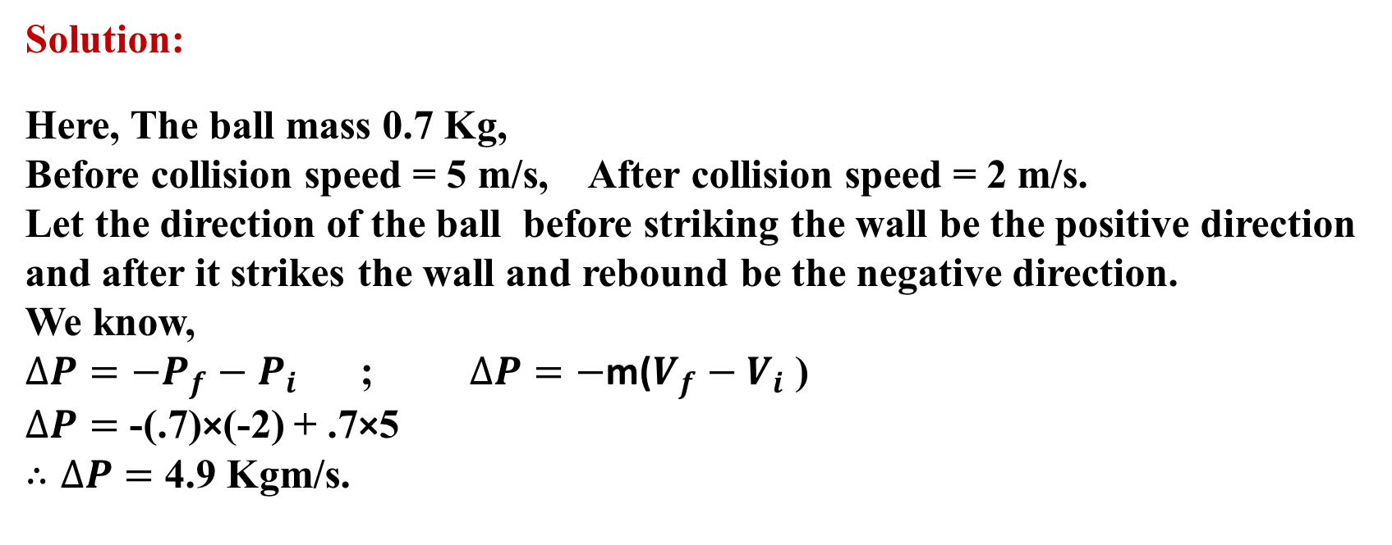
Problems
18. A 70.0 kg ball moving horizontally at 5.0 m/s strikes a vertical wall and rebounds with speed 2.0 m/s. What is the magnitude of the change in its linear momentum?
Solution:
Here, The ball mass 0.7 Kg,
Before collision speed = 5 m/s, After collision speed = 2 m/s.
Let the direction of the ball before striking the wall be the positive direction and after it strikes the wall and rebound be the negative direction.
We know,
$∆P={−P}_{f}−P_{i}$ ; $∆P=−$m($V_{f}−V_{i}$ )
$∆P=$ -(.7)×(-2) + .7×5
$∴∆P=$ 4.9 Kgm/s.

Slide 13
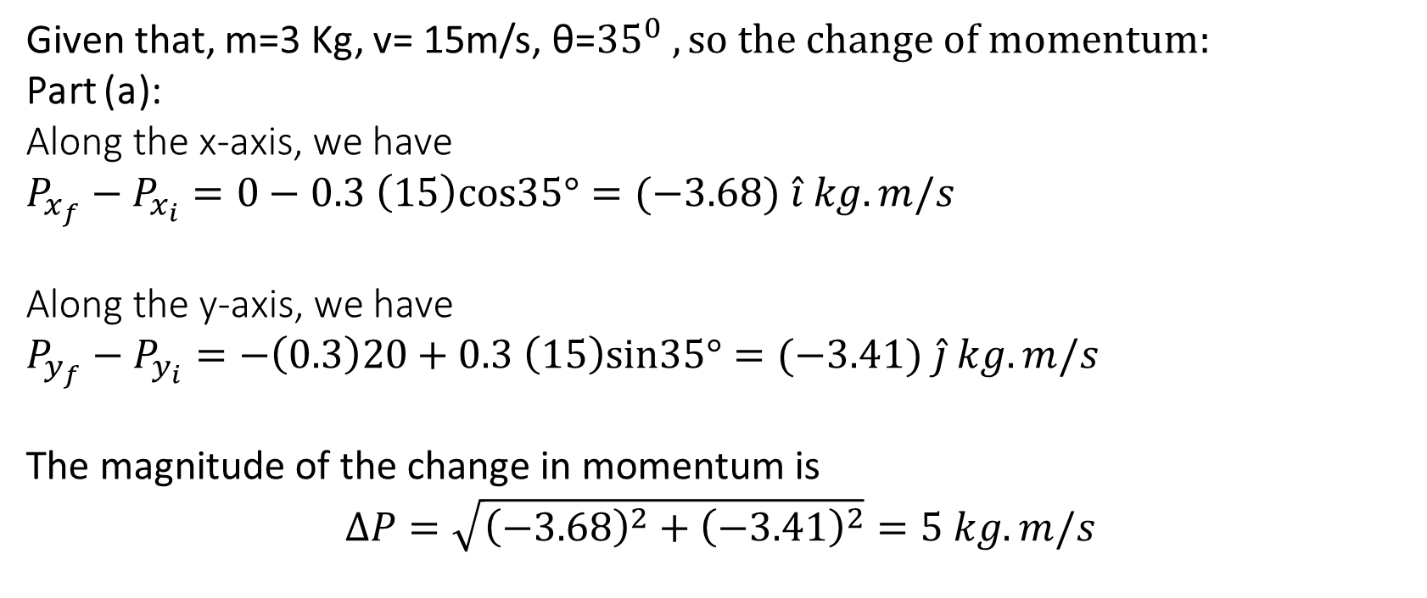
21. A 0.30 kg softball has a velocity of 15 m/s at an angle of 35° below the horizontal just before making contact with the bat. What is the magnitude of the change in momentum of the ball while in contact with the bat if the ball leaves with a velocity of (a) 20 m/s, vertically downward, and (b) 20 m/s, horizontally back toward the pitcher?
Given that, m=3 Kg, v= 15m/s, θ=${35}^{0} , so the change of momentum:$
Part (a):
Along the x-axis, we have
$P_{x_{f}}−P_{x_{i}}=0−0.3 \left(15\right)cos35°=(−3.68) \hat{i} kg.m/s$
Along the y-axis, we have
$P_{y_{f}}−P_{y_{i}}=−\left(0.3\right)20+0.3 \left(15\right)sin35°=(−3.41) \hat{j} kg.m/s$
The magnitude of the change in momentum is
$$∆P=\sqrt{{\left(−3.68\right)}^{2}+{\left(−3.41\right)}^{2}}=5 kg.m/s$$

Slide 14
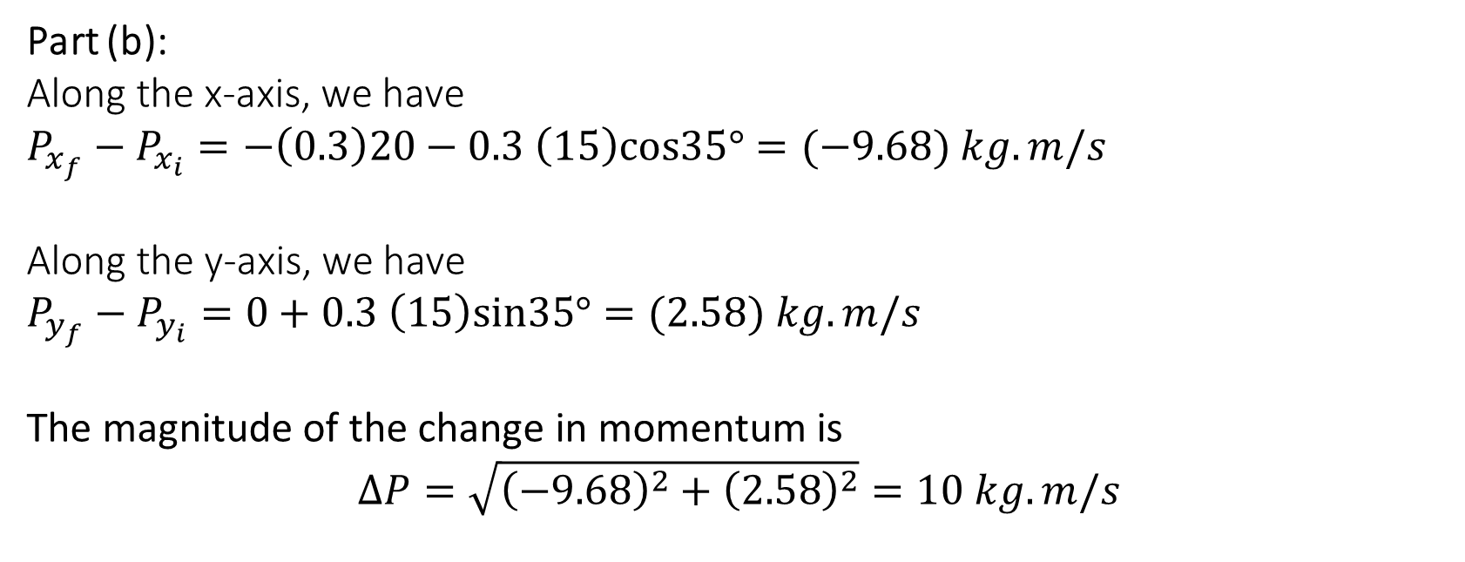
Part (b):
Along the x-axis, we have
$P_{x_{f}}−P_{x_{i}}=−\left(0.3\right)20−0.3 \left(15\right)cos35°=(−9.68) kg.m/s$
Along the y-axis, we have
$P_{y_{f}}−P_{y_{i}}=0+0.3 \left(15\right)sin35°=(2.58) kg.m/s$
$$\text{The} \text{magnitude} \text{of} \text{the} \text{change} \text{in} \text{momentum} \text{is}$$
$$∆P=\sqrt{{\left(−9.68\right)}^{2}+{\left(2.58\right)}^{2}}=10 kg.m/s$$

Slide 15
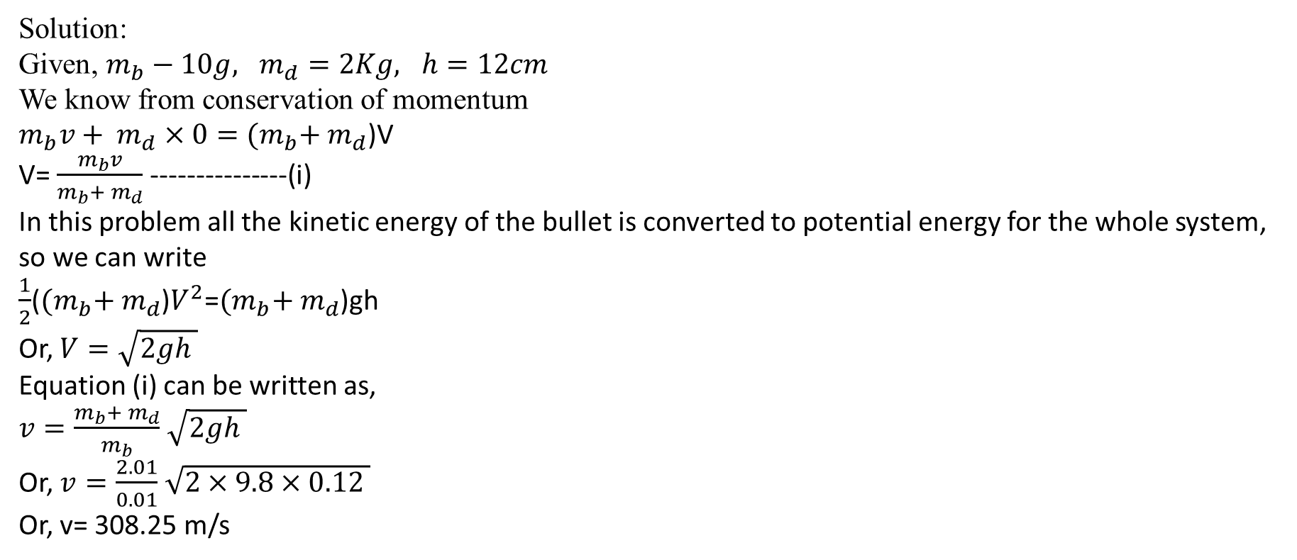
21. A bullet of mass 10 g strikes a ballistic pendulum of mass of 2.0 kg. The center of mass of the pendulum rises a vertical distance of 12 cm. Assuming that the bullet remains embedded in the pendulum, calculate the bullet’s initial speed.
Solution:
Given, $m_{b}−10g, m_{d}=2Kg, h=12cm$
We know from conservation of momentum
$m_{b}v+ m_{d}×0={(m}_{b}+ m_{d}$)V
V= $\frac{m_{b}v}{m_{b}+ m_{d}}$ ---------------(i)
In this problem all the kinetic energy of the bullet is converted to potential energy for the whole system, so we can write
$\frac{1}{2}$(${(m}_{b}+ m_{d}$)$V^{2}$=${(m}_{b}+ m_{d}$)gh
Or, $V=\sqrt{2gh }$
Equation (i) can be written as,
$v=\frac{m_{b}+ m_{d}}{m_{b}}$ $\sqrt{2gh }$
Or, $v=\frac{2.01}{0.01}$ $\sqrt{2×9.8×0.12 }$
Or, v= 308.25 m/s

Slide 16

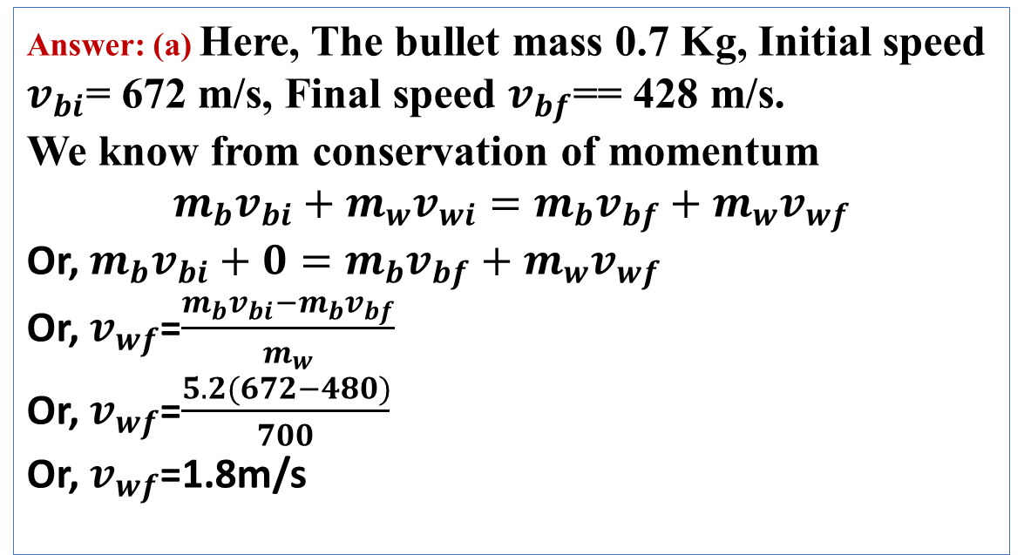
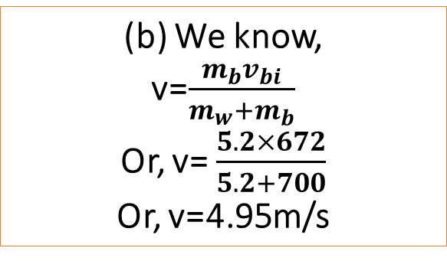
Answer: (a) Here, The bullet mass 0.7 Kg, Initial speed $v_{bi}$= 672 m/s, Final speed $v_{bf}$== 428 m/s.
We know from conservation of momentum
$$m_{b}v_{bi}+{m_{w}v}_{wi}=m_{b}v_{bf}+{m_{w}v}_{wf}$$
Or, $m_{b}v_{bi}+0=m_{b}v_{bf}+{m_{w}v}_{wf}$
Or, $v_{wf}$=$\frac{m_{b}v_{bi}−m_{b}v_{bf}}{m_{w}}$
Or, $v_{wf}$=$\frac{5.2(672−480)}{700}$
Or, $v_{wf}$=1.8m/s
(b) We know,
v=$\frac{m_{b}v_{bi}}{m_{w}+m_{b}}$
Or, v= $\frac{5.2×672}{5.2+700}$
Or, v=4.95m/s

Slide 17
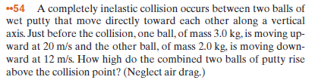
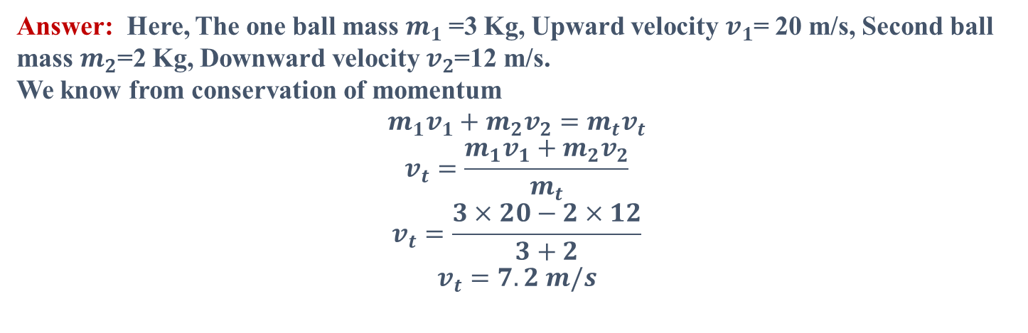
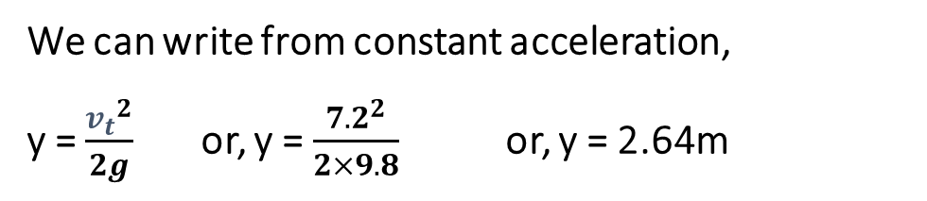
Answer: Here, The one ball mass $m_{1}$=3 Kg, Upward velocity $v_{1}$= 20 m/s, Second ball mass $m_{2}$=2 Kg, Downward velocity $v_{2}$=12 m/s.
We know from conservation of momentum
$$m_{1}v_{1}+{m_{2}v}_{2}=m_{t}v_{t}$$
$$v_{t}=\frac{m_{1}v_{1}+{m_{2}v}_{2}}{m_{t}}$$
$$v_{t}=\frac{3×20−2×12}{3+2}$$
$$v_{t}=7.2 m/s$$
We can write from constant acceleration, y = $\frac{{v_{t}}^{2}}{2g}$or, y = $\frac{{7.2}^{2}}{2×9.8}$or, y = 2.64m

Slide 18

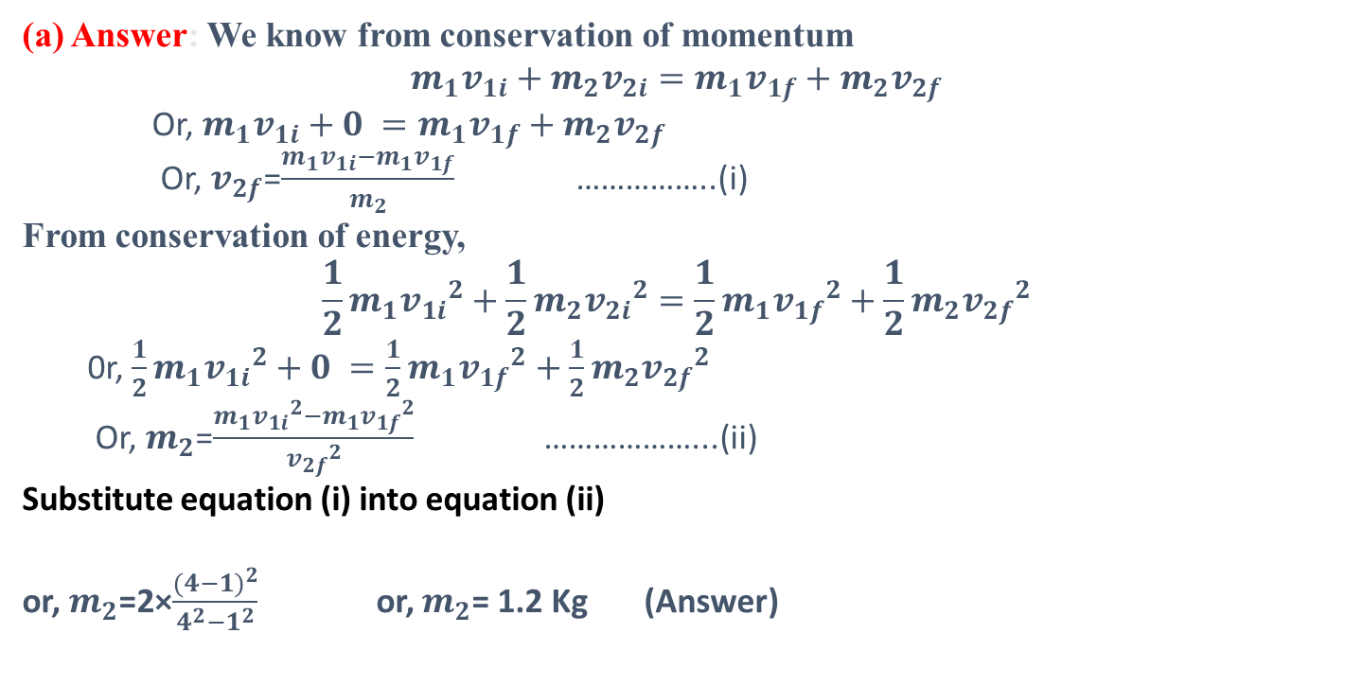
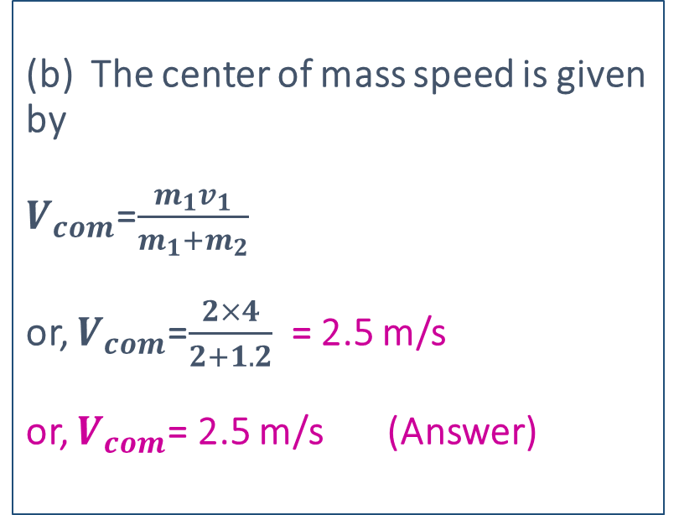
(a) Answer: We know from conservation of momentum
$$m_{1}v_{1i}+{m_{2}v}_{2i}=m_{1}v_{1f}+{m_{2}v}_{2f}$$
Or, $m_{1}v_{1i}+0 =m_{1}v_{1f}+{m_{2}v}_{2f}$
Or, $v_{2f}$=$\frac{m_{1}v_{1i}−m_{1}v_{1f}}{m_{2}}$ ……………..(i)
From conservation of energy,
$${\frac{1}{2}m}_{1}{v_{1i}}^{2}+{\frac{1}{2}m}_{2}{v_{2i}}^{2}={\frac{1}{2}m}_{1}{v_{1f}}^{2}+{\frac{1}{2}m}_{2}{v_{2f}}^{2}$$
0r, ${\frac{1}{2}m}_{1}{v_{1i}}^{2}+0 ={\frac{1}{2}m}_{1}{v_{1f}}^{2}+{\frac{1}{2}m}_{2}{v_{2f}}^{2}$
Or, $m_{2}$=$\frac{m_{1}{v_{1i}}^{2}−m_{1}{v_{1f}}^{2}}{{v_{2f}}^{2}}$ ………………...(ii)
Substitute equation (i) into equation (ii)
or, $m_{2}$=2×$\frac{{(4−1)}^{2}}{4^{2}−1^{2}}$or, $m_{2}$= 1.2 Kg (Answer)
(b) The center of mass speed is given by $V_{com}$=$\frac{m_{1}v_{1}}{m_{1}+m_{2}}$ or, $V_{com}$=$\frac{2×4}{2+1.2}$ = 2.5 m/s
or, $V_{com}$= 2.5 m/s (Answer)

Slide 19
THANK YOU

